Slide 1
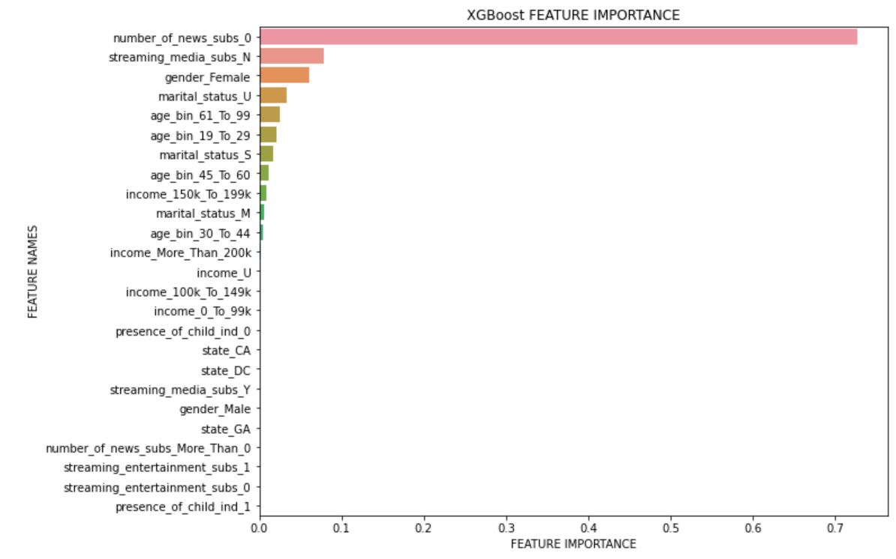
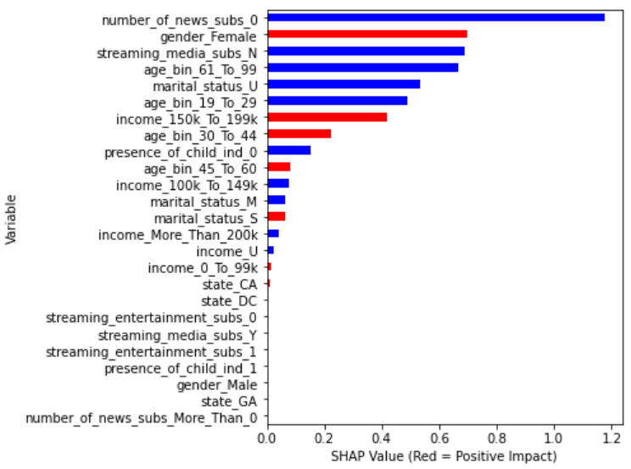
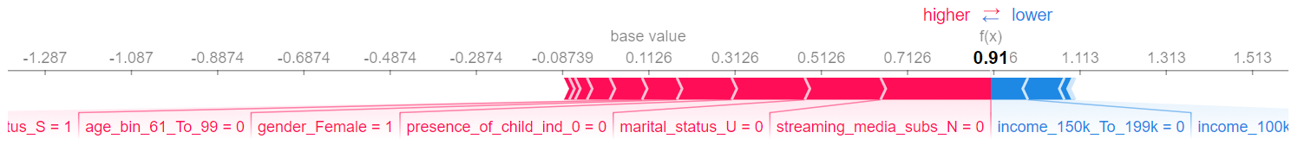
Model Performance and Interpretation
Great Performance
Average AUC: 0.9724; Average Accuracy: 0.9524
Important Predictors
Number of subscriptions to news services is the most important predictor, followed by if subscribed to streaming services and Gender.
Inside of the “black box”:
Propensity Driver – variables that have positive impact on model output:
gender_female, income_150k_to_199k, age_bin_30_to_44, age_bin_45_to_60, marital_status_S
Take user anon_person_id = 999030 as an example:
Being a 61 to 99 y/o single female with no child residing in home who subscribes to streaming media service drives her Propensity Score higher, however, income not being between 150k to 199k lowers her Propensity Score.

Slide 2
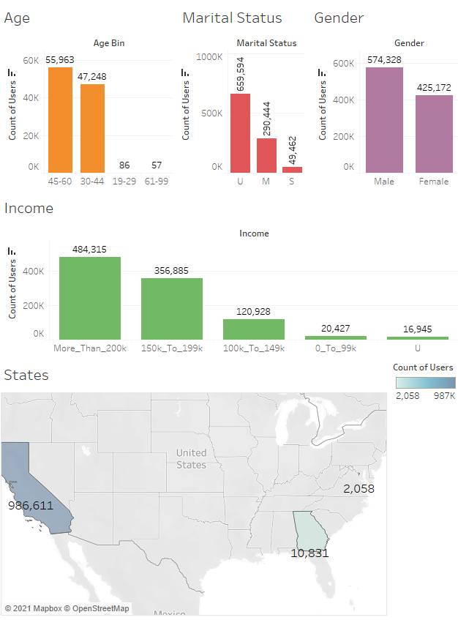
Target User Persona
For the users we decide to pursue:
Most of them are between 45-60 years old.
Most of them have unknown marital status. Among those who’s status are known, most of them are married.
There are more male than female users.
Most of them have income more than 200k
Most of them live in CA, followed by GA and DC.

